Slide 1
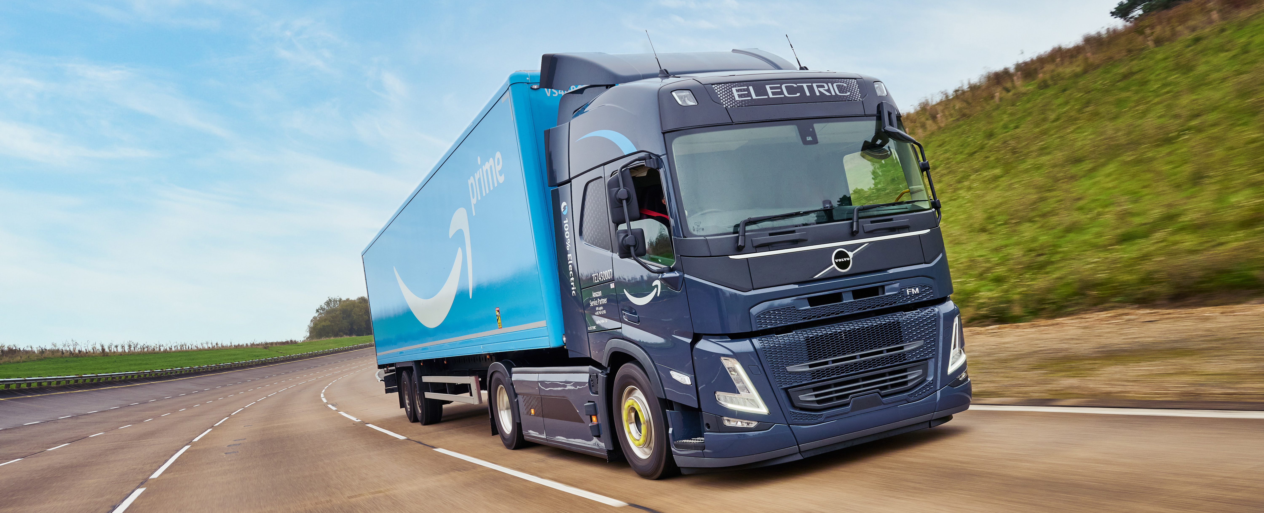
Peak Season Success Guide 2025
Secure capacity. Protect compliance. Keep goods flowing into fulfillment centers.
© 2025 Amazon.com, Inc. or its affiliates. All rights reserved.

Slide 2

Why peak planning matters
Q4 brings surging demand and less flexibility in the network. Early, accurate planning can make the difference between a smooth delivery and a costly disruption.
Shippers who prepare ahead of time secure more reliable capacity and reduce the risk of rejected or delayed loads.
Surging demand
Less flexibility in slots
Risk of pushouts

Slide 3
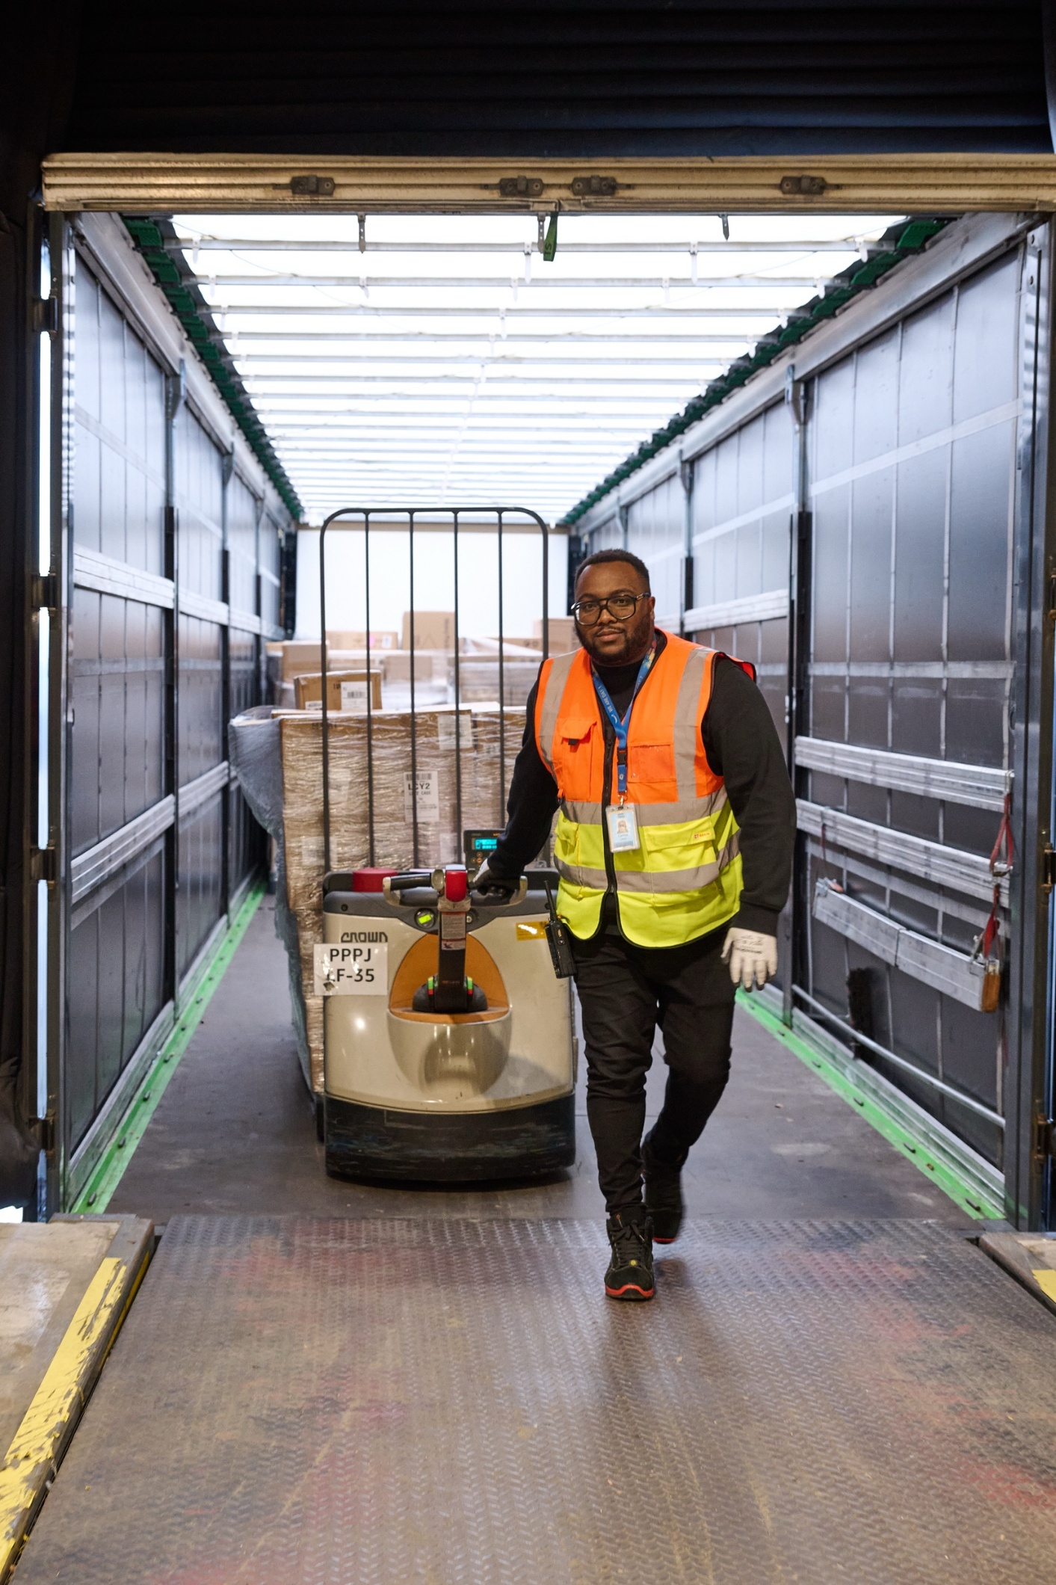
From booking to delivery: get every step right
1. Order lead time
Book at least 48h before pickup
Allows carrier assignment and enables accurate appointment scheduling at FCs
Provide buffer for document verification and compliance checks, preventing last-minute cancellations or reschedules
2. Accurate value & unit counts
Double-check pallet counts and unit counts, they should be identical
Ensure accurate information are provided including but not limited to weight and PO numbers
Add your Total Shipment Value
3. PO Accuracy
Don’t reuse BOL and ASN for multiple shipments
Check PO expiration dates before booking
Validate PO numbers are active in the system
4. Fulfilment Centers (FC) Compliance
Valid BOL (Bill of Landing) and ASN for vendors or accurate FBA for sellers
Proper carton and pallet labels
Tip:
Keep your Account Manager informed about volume changes to prevent disruptions such as FC / destination FC changes.

Slide 4
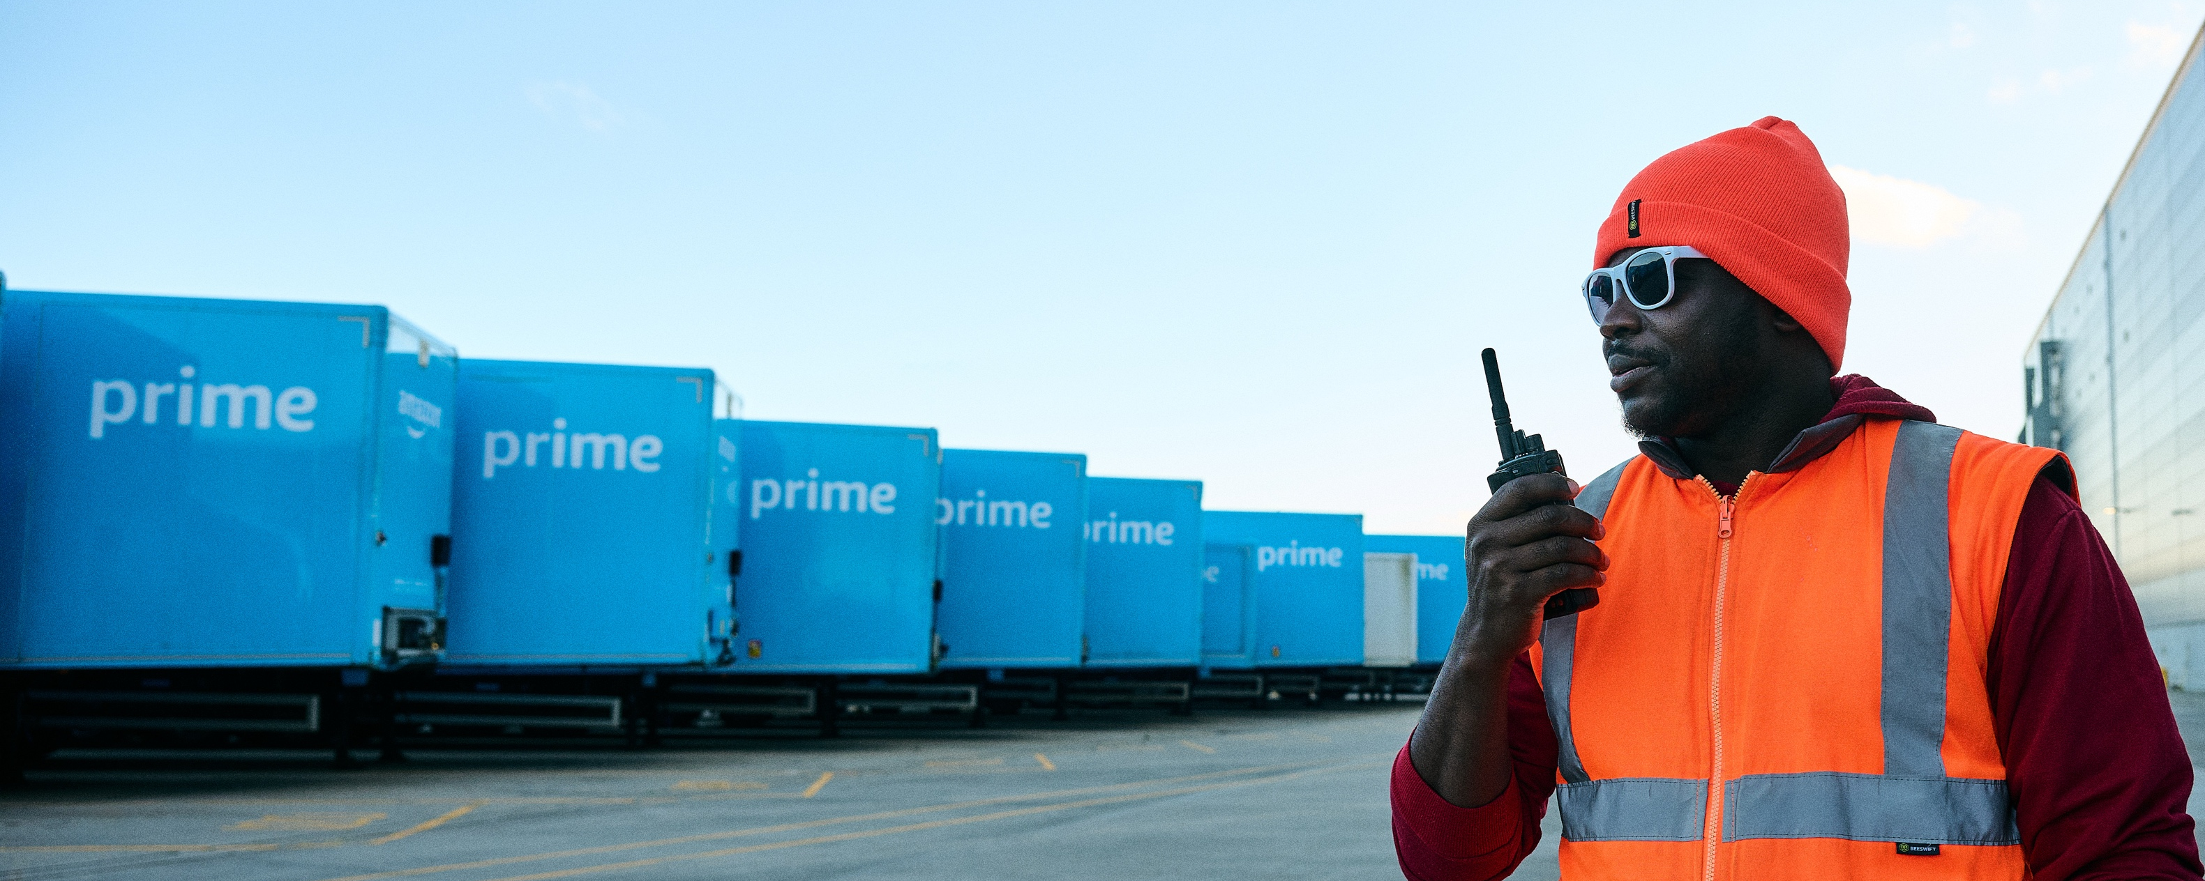
Smart booking: protect your slot
Cancellations ripple through the network.
Avoid disruptions with these booking/cancelling practices:
Be specific:
use the correct cancel reason codes so we can identify patterns and prevent repeat issues.
Think reschedule:
For vessel or customs delays, try rescheduling before cancelling. Notify your account manager early with the delay and new ETA.
48h+ Hour Rule
Cancel early to help us reallocate capacity
Heads up: New T&Cs from mid-September: cancellations <48h may incur fees.

Slide 5
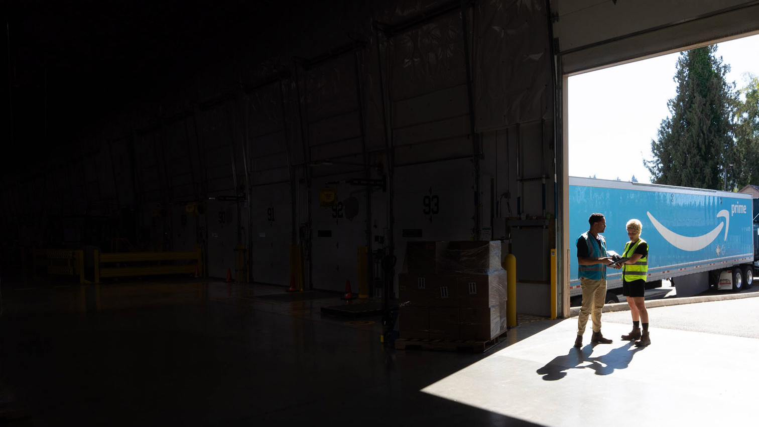

Prepare every pallet for success
Correct wood pallets (UK: 1000x1200mm / EU: 800x1200mm).
Stack heavy to light; max height 180cm (single) / 2.7m–3.0m (double, market specific).
Oversized goods: strap 2 pallets together (short side).
Limit overhang to 20cm total.
Wrap securely: clear stretch film, 5 wraps minimum, no knots at pallet base.
Apply Heavy Pallet label (>500kg).
Keep under 1000kg per pallet.
Load tight; use restraints evenly.
Leave 15cm clearance at rear for dock leveler.
Secure with load bars/straps.
Pallets must face short side toward trailer door.
Seal trailers for inbound loads.
Download the full manual on Vendor Central / Seller Central

Slide 6
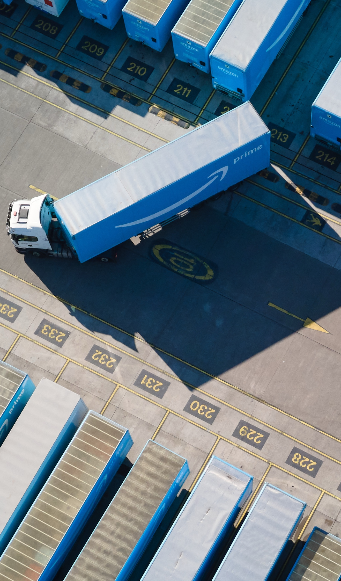
Extend hours, unlock more capacity
Fulfillment Centers run 24/7 — but many shippers close by 6PM. Extend your shipping window into the evening to:
Extended Hours Advantage:
Push your operating window into the night to access more available slots
Night Delivery Benefits:
Take advantage of less congested night slots while other shippers are closed
Success Data:
Shippers operating until 10PM or later consistently secure more slots and reduce pushouts

Slide 7
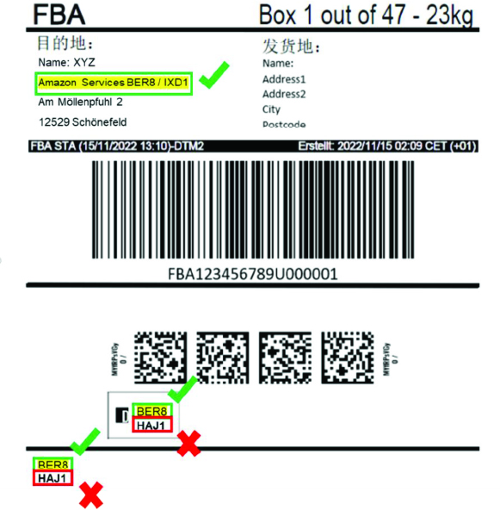
Sort Center rules to remember
Sort Center POs must go only to designated SCs
Do not reroute to FCs (e.g., DTM2, HAJ1, WRO5, BHX4)
Incorrect destinations = rejected load
Verify SC codes on labels
Follow SC instructions exactly

Slide 8
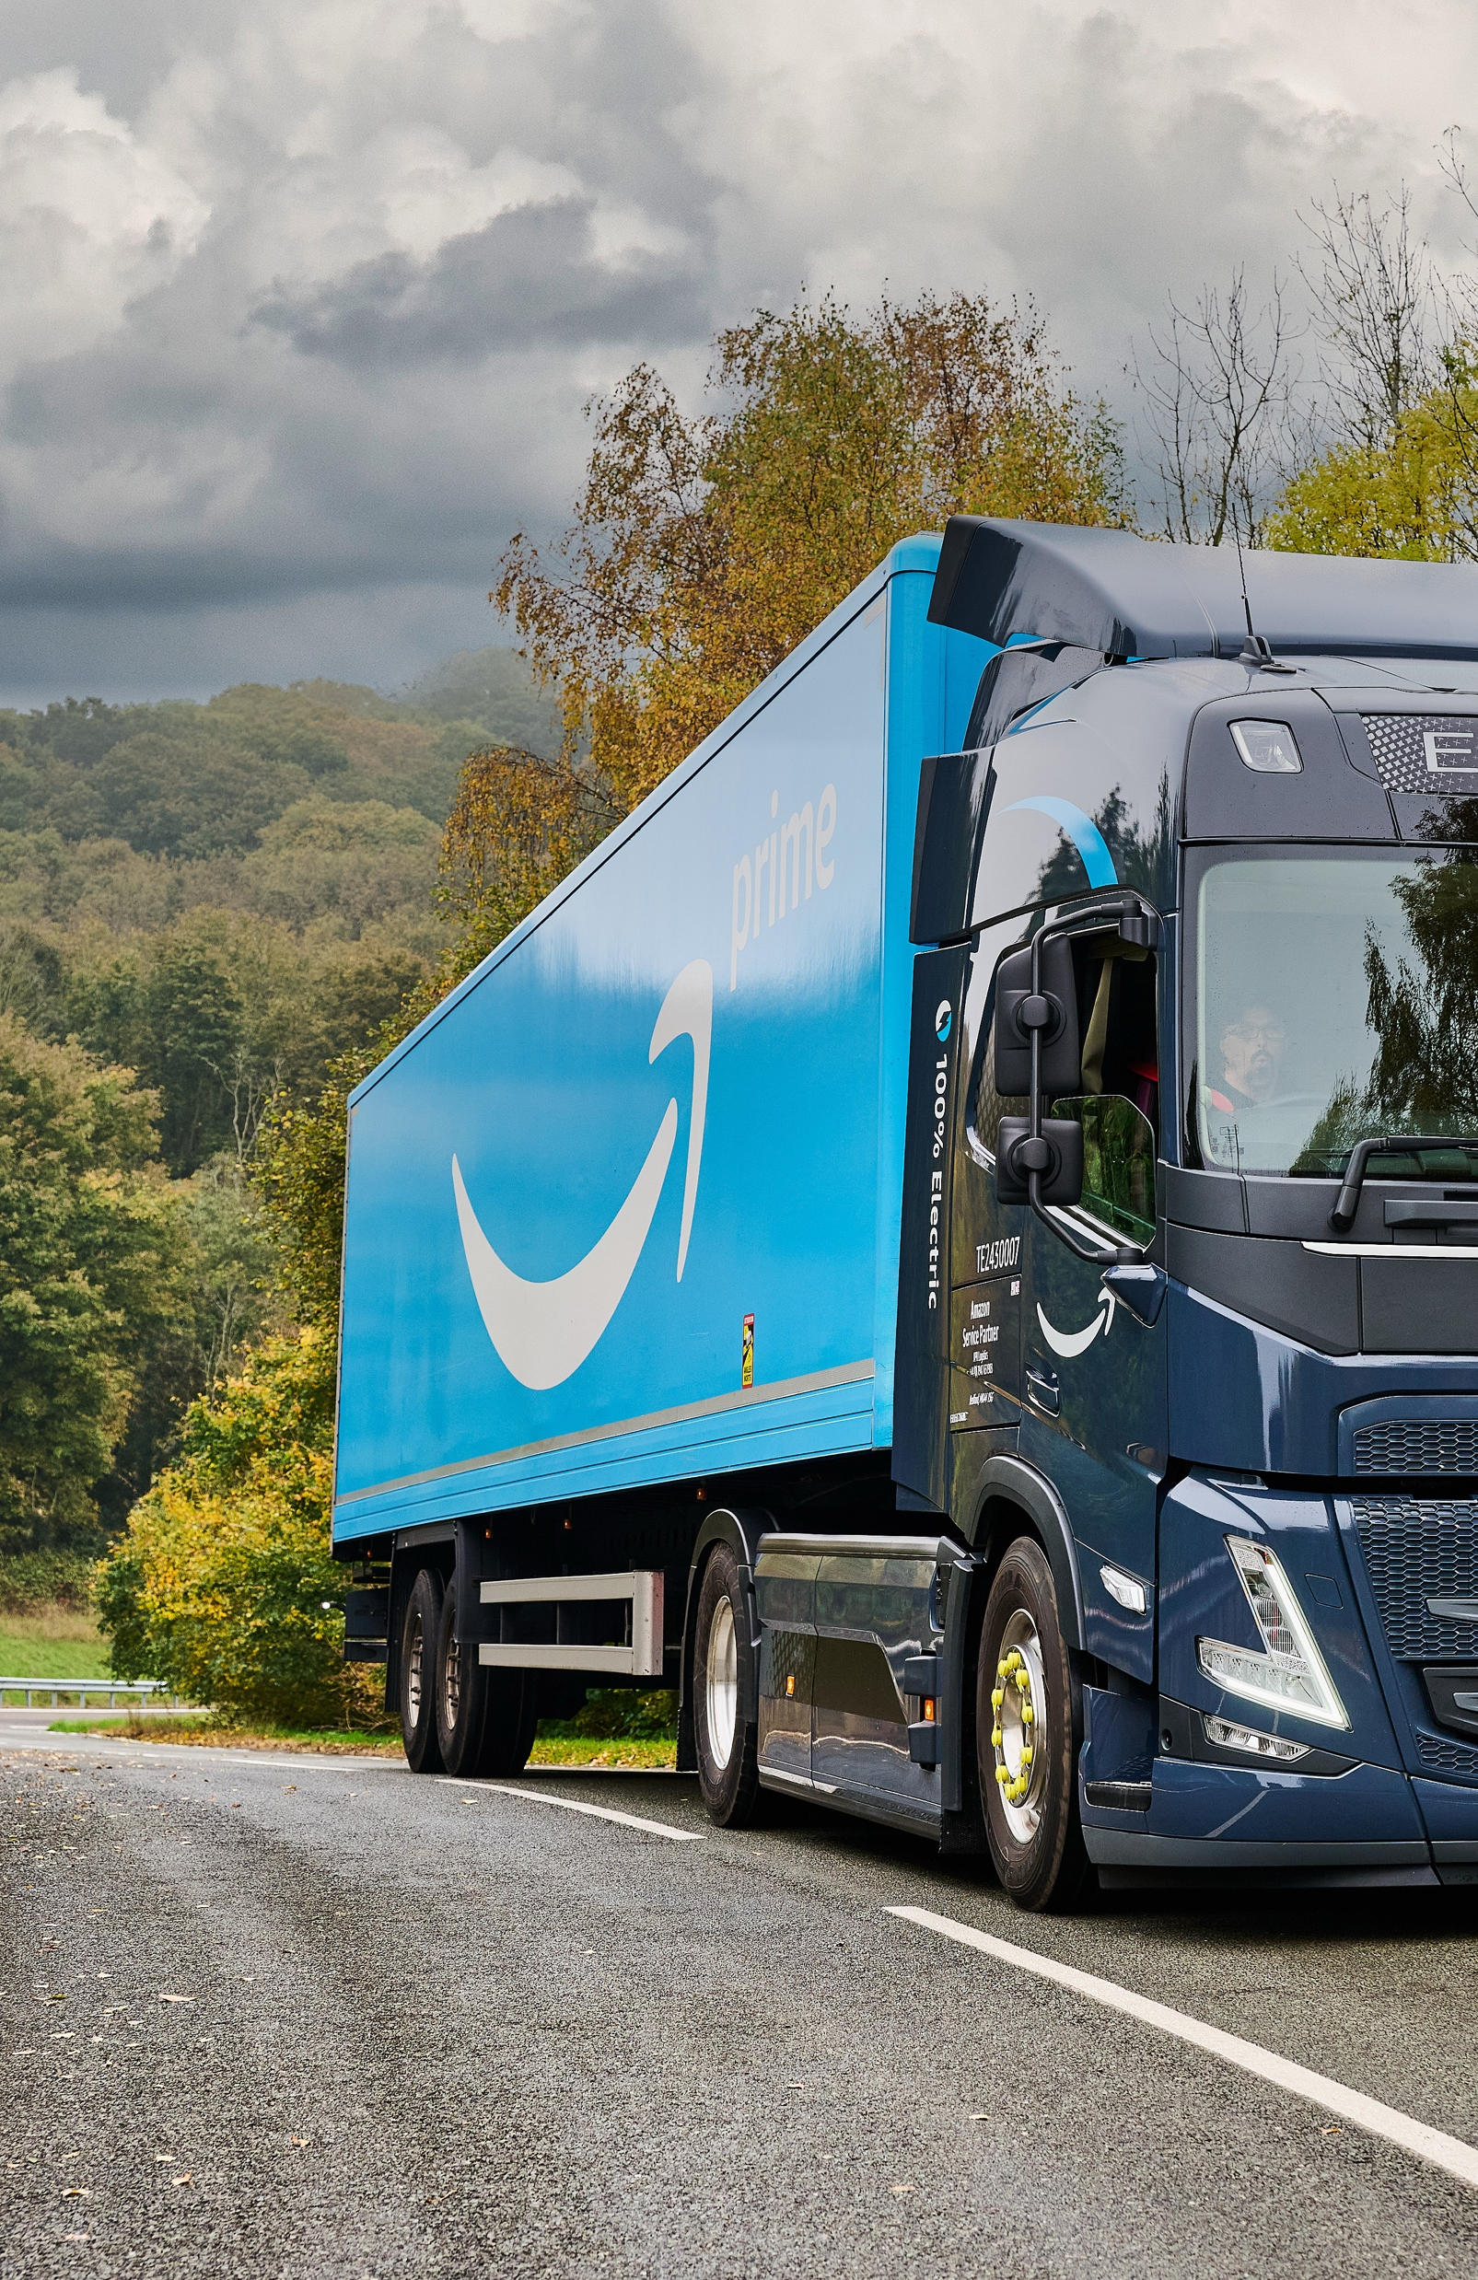
Amazon Freight:
understanding our role
Misconception 1:
Amazon Freight owns all its trucks and directly employs drivers, so it should have full control over operations. Rescheduling or equipment issues are the result of mismanagement.
Correction:
Amazon Freight does not fully own its fleet or directly employ all drivers. We leverage a strategic network of Amazon-managed fleets and trusted carrier partners to provide comprehensive coverage and flexible capacity.
This diverse supply model enables us to serve more customers efficiently.
Equipment availability and scheduling can be affected by factors across the partner network.
We maintain high service standards through rigorous partner selection and integrated systems, and continuously optimize coordination across the network.

Slide 9
Amazon Freight:
understanding our role
Misconception 2:
Amazon Freight issues chargebacks, so disputes should be addressed to Amazon Freight.
Correction:
Chargebacks are managed by the Amazon Retail team through Vendor Central. Amazon Freight supports you in navigating the process:
Step 1: Submit disputes in Vendor Central within 30 days of issuance.
Step 2: If denied, contact freight-vendor-chargebacks@amazon.com, especially for: ASN/BOL mismatches, PO delivery timing issues, No-call/no-show cases, Load rejections
Pro tip: Always include your original dispute documentation and Retail response for faster review.

Slide 10
Amazon Freight:
understanding our role
Misconception 3:
Amazon Freight can predict or provide advance warning of FC pushouts before other carriers.
Correction:
All carriers operate under the same FC receiving protocols. What sets Amazon Freight apart is our technology advantage:
Real-time shipment visibility through integrated systems
Proactive risk monitoring via the Pull Forward tool
Advanced scheduling tools for optimized deliveries
End-to-end tracking from quote to payment
Our tech helps us:
Identify scheduling risks earlier
Find alternative delivery slots when needed
Provide enhanced shipment visibility
Maintain consistent, reliable service standards

Slide 11
Amazon Freight:
understanding our role
Misconception 4:
Amazon Freight should reroute freight to other FCs with available capacity to reduce pushouts.
Correction:
FC destinations are strategically assigned through Vendor/Seller Central using an automated system designed to optimize product placement across the network.
Destination Management
FC assignments are product-based
Routing is automated via Vendor/Seller Central
Network adjustments happen at system level
Our role:
Execute reliable delivery to assigned FCs
Provide real-time tracking and visibility
Support efficient scheduling and planning
Maintain delivery compliance

Slide 12
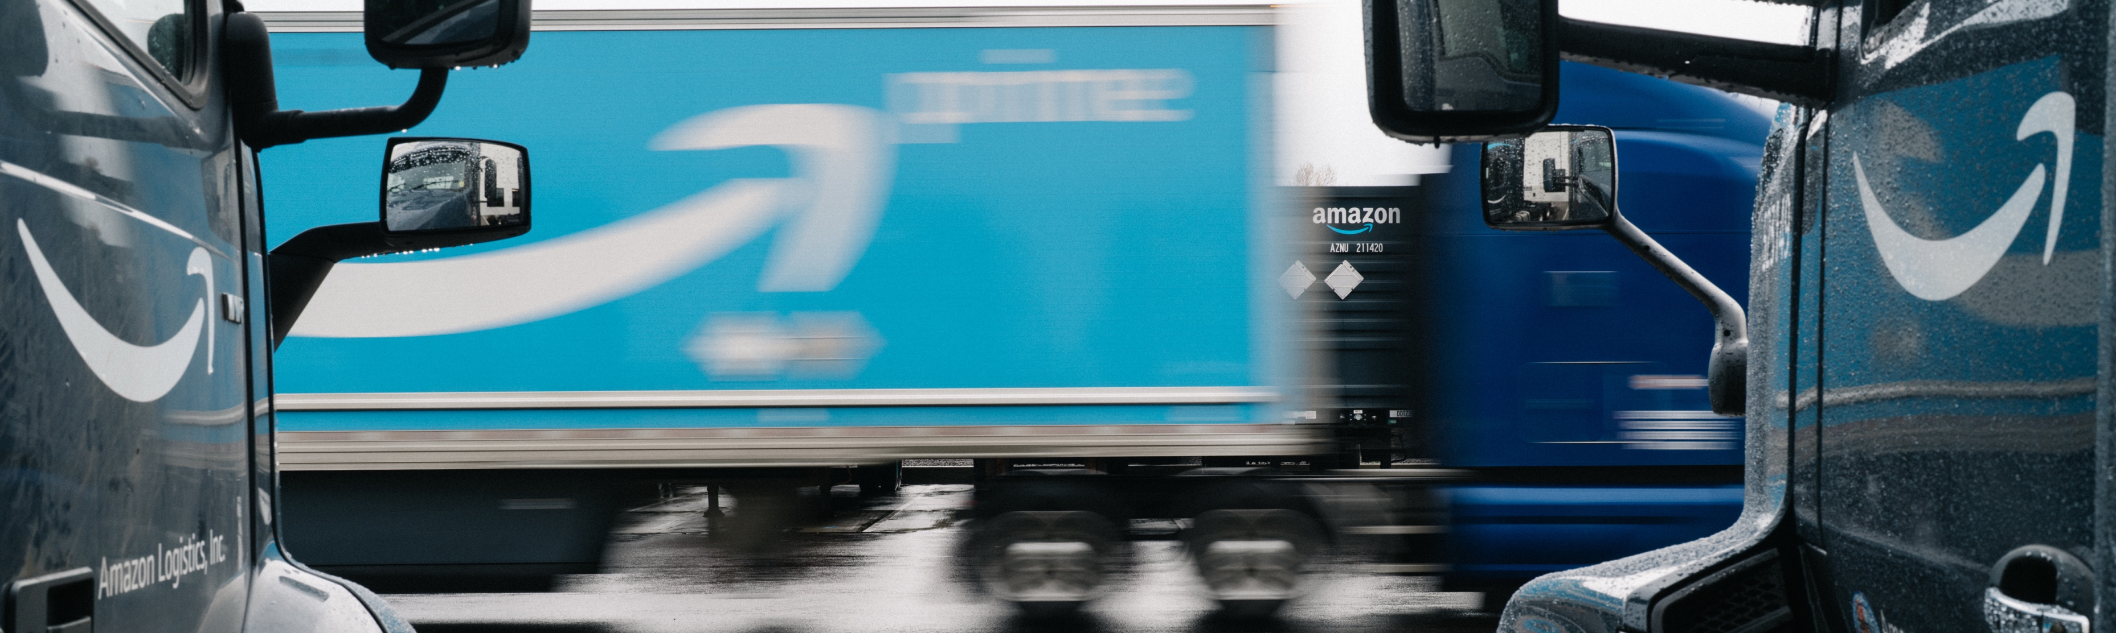
Let’s get shipping.
© 2025 Amazon.com, Inc. or its affiliates. All rights reserved.

